Slide 1
DATA SCIENCE
Rats and Wages
Predicting wage violations from health inspection data.

Slide 2
Outline
Data science pipeline / twilight zone
Question
Data background/ description
Pitfalls, failures, challenges, dead ends, problems, black hole/twilight zones
“Success”
Next steps

Slide 3
Data Science Twilight Zone
I. Define the problem / question
II. Identify and collect data
III. Explore and prepare data
IV. Build and evaluate model
V. Communicate results

Slide 4
Data Science Twilight Zone
I. Define the problem / question
II. Identify and collect data
III. Explore and prepare data
IV. Build and evaluate model
V. Communicate results

Slide 5


Slide 6

Data Science Twilight Zone
I. Define the problem / question
II. Identify and collect data
III. Explore and prepare data
IV. Build and evaluate model
V. Communicate results

Slide 7
I. Define the problem / question
Can you predict which businesses break wage laws based on information available in open data sets?

Slide 8
DISCLAIMER
The contents of this power point are my own and do not reflect the position of the US government or the Department of Labor.
Don’t get me fired

Slide 9
Department of Labor , Wage and Hour :
“The Wage and Hour mission is to promote and achieve compliance with labor standards to protect and enhance the welfare of the Nation's workforce.”

Slide 10
Data background/ description
Wage and Hour Enforcement Data Set
https://data.cityofnewyork.us/Health/DOHMH-New-York-City-Restaurant-Inspection-Results/xx67-kt59
DOHMH_New_York_City_Restaurant_Inspection_Results.csv
New York City Restaurant Inspection Results
https://nycopendata.socrata.com/

Slide 11
DOL WHD Data set
Data with 188,000 rows
Each row represents a DOL investigation Case that has close
Each row has 99 columns, however:
Only 10 columns have feature information
Really only 3 things you can tell from those columns:
Business Name, address, and industry type
The industry column is messed up
Other columns are response variables, different outcomes for different acts, many that have nothing to do with most cases.

Slide 12
NYCDOH
520392 rows x 18 columns
25349 unique businesses
Columns:
CAMIS DBA BORO BUILDING STREET , ZIPCODE PHONE
CUISINE DESCRIPTION INSPECTION DATE
ACTION VIOLATION CODE
VIOLATION DESCRIPTION
CRITICAL FLAG
SCORE
GRADE
GRADE DATE
RECORD DATE
INSPECTION TYPE

Slide 13
Wage and Hour
Wage and hour cases that also have
DOH inspection data
New York City Department of Health
Wage and hour New york City

Slide 15
III. Explore and prepare data
Both data sets have address columns.
How hard can it be to merge them on the address ?

Slide 16

III. Explore and prepare data
Turns out, there are many ways to write the
Same address in New York City, and also
Those different ways can look like other
Addresses if you try and simplify them.

Slide 17
III. Explore and prepare data
1515394 Tommaso Restaurant Thomas Caterers Inc. 1464 86th Street Brooklyn NY 11228
AVENUE as AVE
Street as ST
43^{rd AVE} as forty third avenue
DOH only used the five Boroughs, while DOL had 18 names for city name in address
Example= Queens vs. Jackson Heights

Slide 18
III. Explore and prepare data
Strategies
Regex
Geocoding
Sort by zipcode, then by DBA, then Visual
“Split , Apply , Combine”

Slide 19
III. Explore and prepare data
Combine data set:
60 restaurants with both DOL and DOH inspections/investigations in New York City
****Looped back to step 1****
I. Define the problem / question
Does a higher DOH score predict DOL violation?

Slide 20
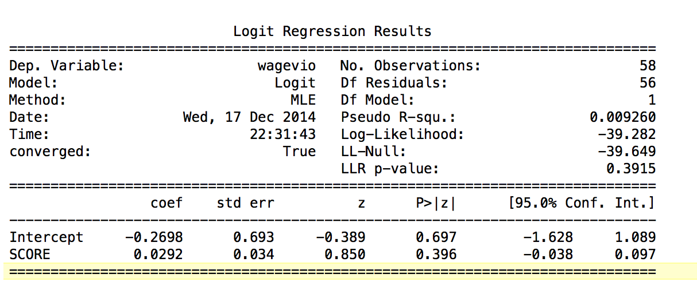
IV. Build and evaluate model

Slide 21
IV. Build and evaluate model
Tried Logistic regression, It was not significant
New strategy, to use linear regression
Violations with backwages, violations without.
Created new response, Average amount of backwages due per employee
Back to step 1:
Define the problem / question
As The highest score that a restaurant has ever gotten goes up, does the average amount due per employee in DOL investigation also go up?

Slide 22
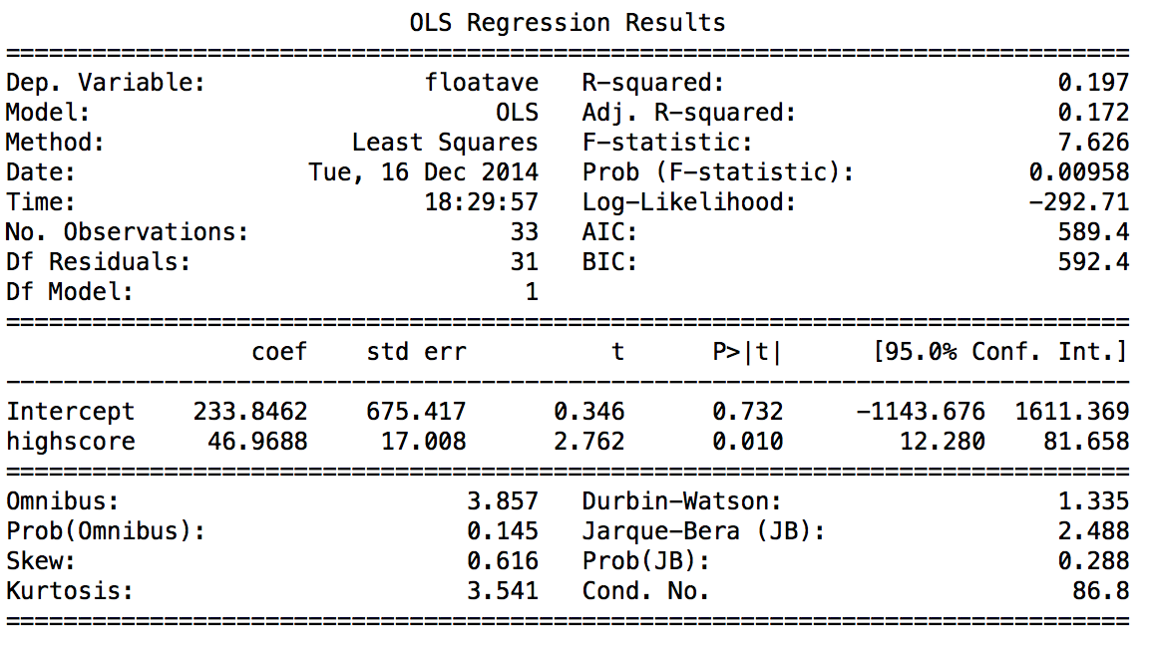
IV. Build and evaluate model

Slide 23
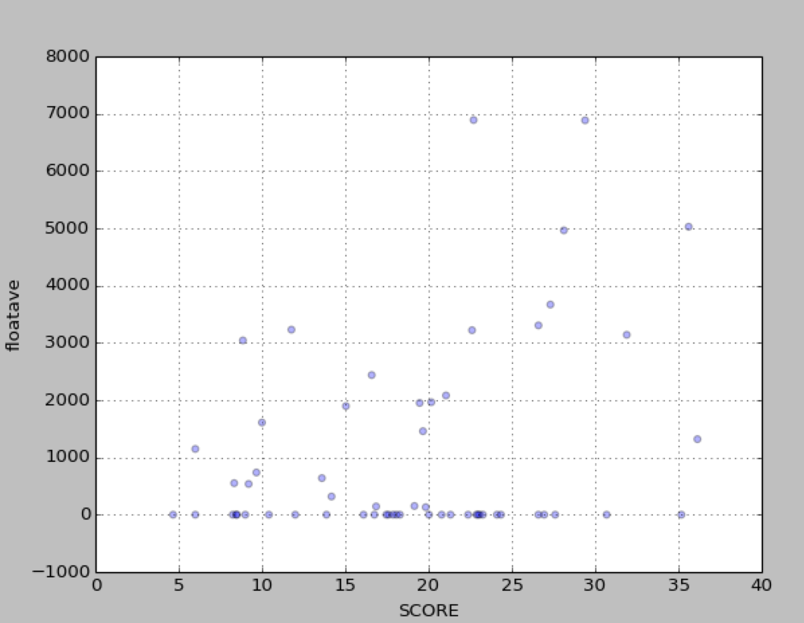

Slide 24
IV. Build and evaluate model
Linear regression suggests relationship:
P = .001 and coef was 61.49
Could help decide which cases to take.
However, data set was small.
Issues with data “Agreed to Pay”
Next steps:

Slide 25

Tidy Data

Slide 26
III. Explore and prepare data
this is a headache
Industry type column North American Industry Classification System
>>> d['types'] =[type(number) for number in d.naic_cd]
d.types.value_counts()
<type 'str'> 122857
<type 'int'> 48741
<type 'float'> 16407
also, for about 50 rows, someone had put in a “48-49”

Slide 27

Next steps:
Tidy Data:
Standardize addresses
Geocode addresses – Lon – Lat
Have a unique field for businesses
Have a standard way to put in business
Names

Slide 28
Next steps:
Brain storm:
Cuisine type?
Break points in score with grades?
Using 538 criteria?
Yelp reviews?
Census data?

Slide 29
Thank you!

